Slide 1
PROJECT ON “AC TO DC CONVERTER WITH VARIABLE VOLTAGE REGULATION SYSTEM”
(Group-3)
Daiyan Ibnul Aswad
Aban Ahmad
Adrija Khastagir
Quafshad Tayush Nur

Slide 2
Introduction
Brief overview of the project requirements:
DC or Direct Current is a one-way current that gives constant values in each interval while AC or Alternating Current is a two-way current that fluctuates at each interval.
In this project, using a variable voltage regulation system, our objective is to convert the input AC voltage into output DC voltage through four processes: transformation, rectification, filtration or smoothing and finally load regulation.
Through this variable voltage regulation system-based AC-to-DC conversion circuit, the outcome should exhibit efficiency and stability across a range of input voltages, addressing factors such as load variations, ripple minimization, and practical applications.
Importance of AC to DC conversion and variable voltage regulation:
AC to DC conversion is crucial in electronic systems as many devices and components operate on DC power. They are also essential in long-distance power transmissions in order to produce efficient energy cycles along with charging batteries.
Variable voltage regulation is equally important, providing adaptability to different applications with varying power requirements. This design enables the creation of a reliable power source that can be adjusted as needed, and can even protect from overvoltage and undervoltage conditions.

Slide 3
Problem Statement
Recap of the project question:
The project involves designing a versatile AC-to-DC conversion circuit with variable voltage regulation to ensure stability and efficiency across diverse input voltages.
Challenges and considerations in designing the circuit:
To design a variable voltage regulation circuit, consider selecting efficient components, optimizing circuit topology, and integrating heat dissipation mechanisms. The circuit should maintain a stable output voltage with minimal ripple and respond quickly to changes in input voltage or load conditions.
The circuit design should also eliminate electromagnetic interference by having proper shielding, filtering and grounding techniques, and consider cost constraints while balancing performance requirements. The operating environment, including temperature, humidity, and altitude, must also be taken into account.

Slide 4
Key Stages during the Conversion:
Transformer: Transformers facilitate the transmission of power at high voltages (for reduced losses) and enable the conversion of voltage levels to match the requirements of the downstream components.
Rectification: Converting AC to DC is essential because most electronic devices and components operate on DC power. Rectification ensures that the current flows in a unidirectional manner, preparing it for further processing in the voltage regulation stage.
Voltage Regulation: Stable voltage output is crucial for the proper functioning and longevity of electronic devices. Voltage regulation ensures that the connected devices receive a consistent and appropriate voltage level, preventing potential damage from overvoltage or undervoltage conditions.
Load Regulation: Stable output under varying loads. Devices connected to the power supply may have varying power requirements. Load regulation ensures that the power supply can adapt to these changes, providing a constant and reliable voltage to the connected devices.

Slide 5
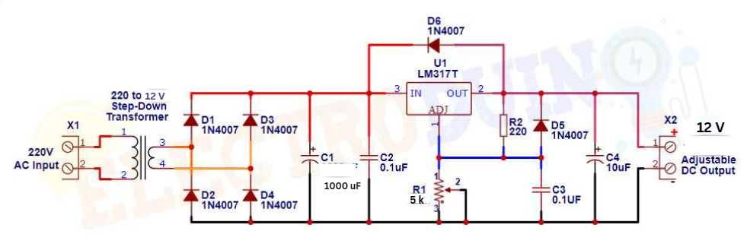

Circuit Diagram with the Key Stages
Transformer
Voltage Regulation
Load Regulation
Rectification

Slide 6
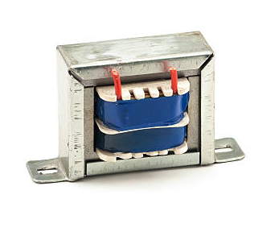
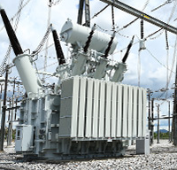
Transformers
Transformers are electrical devices that has the ability to increase or decrease voltages through electromagnetic induction.
Transformers are used to step up or step down voltage.
Step up transformers are used from production grid to transmission line to increase the voltage for efficient power transmission.
Step down transformers are used to decrease voltage from power line to consumption or distribution line.
Transformers work according to the Principle of Mutual Inductance.
Transformers only work for Alternating Current.

Slide 7
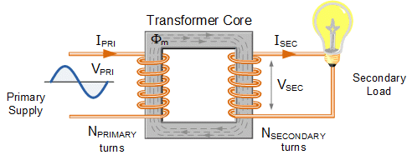
Transformer coil ratio:
Magnetic flux =φ ( same throughout the core)
EMF per turn = e (equal for both winding)
Therefore,
EMF in primary winding, Vp= Np X e
EMF in secondary winding, Vs= Ns X e
Therefore, Vp/Vs = Np/Ns
Types of transformer and coil ratio :
Step-down: n2 < n1 ; n1/n2 >1
Step-up: n2 > n1; n1/n2 <1

Slide 8
Mutual Induction in Transformers
Mutual Induction refers to when a changing magnetic field in one coil induces a voltage in a nearby coil.
AC Current & Magnetic Field: AC current in the primary coil generates a changing magnetic field in the iron core.
Induction in Secondary Coil: Secondary coil, within the magnetic field, experiences induced EMF due to mutual induction.

Slide 9
Rectification stage
Working Principle
Four diodes arranged in a simple bridge-like setup
AC Input is Connected to two diagonally opposite points of the bridge.
Rectification Process
Efficiently utilizes both Halves: Harnesses both positive and negative halves of the AC input.
Direction Control: Ensures current flows from positive to negative ends of the load.
Pulsating DC Output: Conversion from alternating to pulsating direct current.
Full wave bridge rectifier

Slide 10
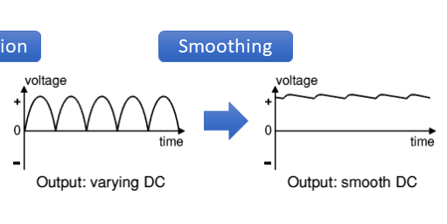
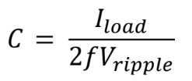
Role of capacitor is smoothing the pulsating DC signal:
A capacitor is used to smooth a pulsating DC circuit. As the voltage of the varying DC voltage starts to decrease the capacitor starts discharging and maintains a relatively stable voltage signal. The value of the capacitance depends of the value of how much current we are expecting through the load resistor, frequency of AC signal and how much ripple we are trying to smooth out.
The value of the capacitance follows the equation -
We can understand from the equation that increasing the value of capacitance will result in better smoothing and Ripple voltage to reduce.

Slide 11
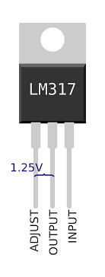
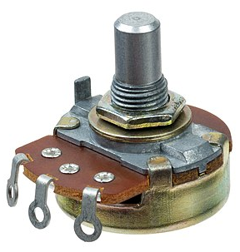
Voltage regulation and Potentiometer
Voltage regulator is a system designed to maintain a constant voltage irrespective of the input voltage.
A variable voltage regulator is a type of regulator which we can use to adjust voltage, maintain
voltage of a certain value, and regulate it using external elements.
LM317 is a linear variable voltage regulator.
The Output voltage of this regulator is determined by the formula - V_{out} = 1.25 {1+ (R1/R2)}
In this formula R1 a fixed value resistor, whereas R2 is variable resistor which we regulate and adjust
Vout accordingly.
A potentiometer is a three-terminal resistor with a sliding or rotating contact that forms an
adjustable voltage divider. If only two terminals are used, one end and the wiper, it acts as a
variable resistor or rheostat.
We use a resistor in the circuit to adjust the value of R2.

Slide 12
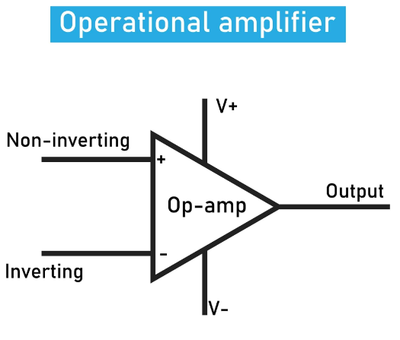
Load Regulation:
Using Operational Amplifier as a Feedback Mechanism in order to maintain stability and get desired output.
Using feedback loop to Ensuring stable output voltage under varying loads.
Source:https://www.google.com/url?sa=i&url=https%3A%2F%2Fresources.pcb.cadence.com

Slide 13
Practical Applications
Desktop Computers and Laptops
Television
Home Appliances
Chargers for Portable Devices
LED Lighting
Factory Automation System
Solar Power Inverter
Home Appliances
Chargers for Portable Devices
LED Lighting

Slide 14
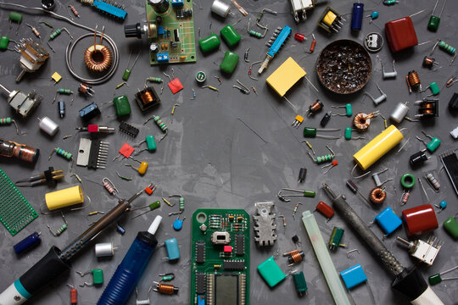
PHYSICAL
SETUP

Slide 15
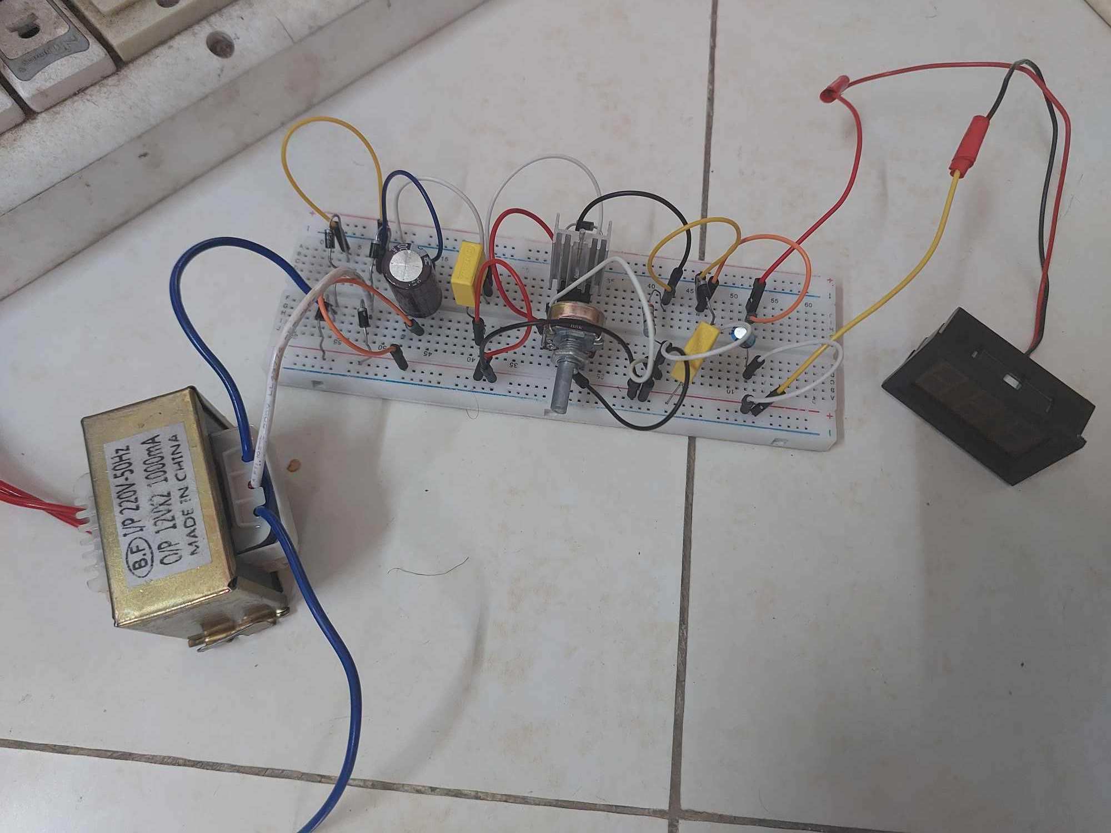

Slide 16
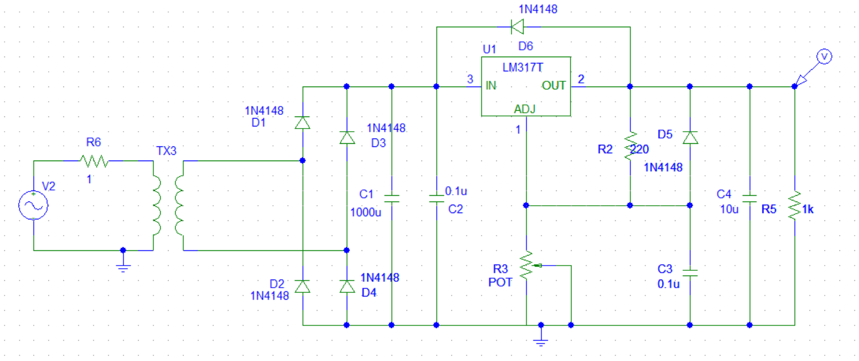
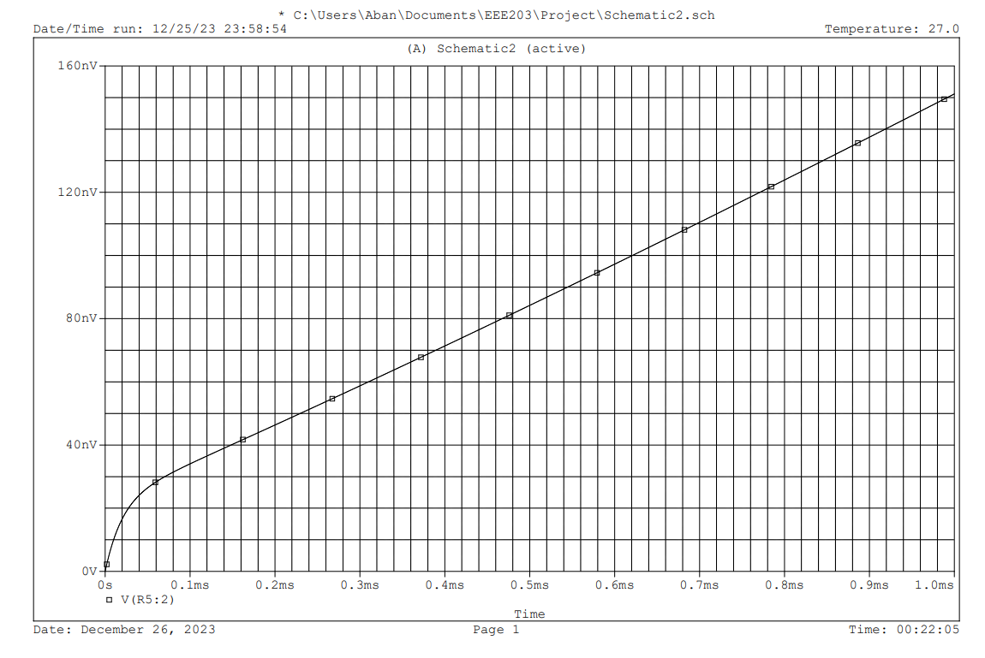
Schematic Diagram:

Slide 17
Consideration for future Improvements:
Increasing Efficiency: 1.Use of semiconductor. 2. Use of switches.
Size Reduction: Smaller Circuit design.
Adaptability Enhancement: 1. Advanced thermal management systems. 2. Advanced Voltage Regulation System. 3. Eco-friendly materials.

Slide 18
Conclusion
Challenges: 1. Overheating 2. Live Connections 3. Calculation Adjustments
Solutions: 1. Using a heat sink 2. Taping of live connections. 3. Taking approximate values
To conclude the designed circuit is an AC to DC converter with a variable voltage regulator. The variable voltage regulator is LM317. The transformer we used would ideally have an input of 220V AC and convert it to 12V DC. We successfully conducted the experiment and found the output voltage 8.89V which is close to the rms value of ideal 12V which is 8.45V.

